Slide 1
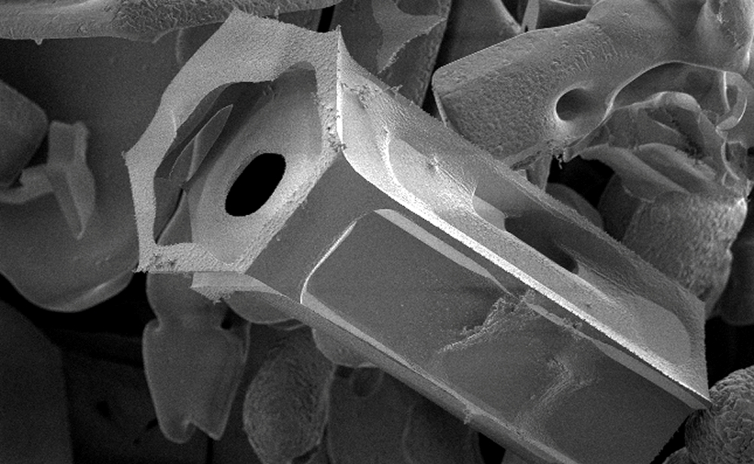
Join us for a Tiny Adventure!
Affelia Wibisono
and Toby Shannon-Smith

Slide 2
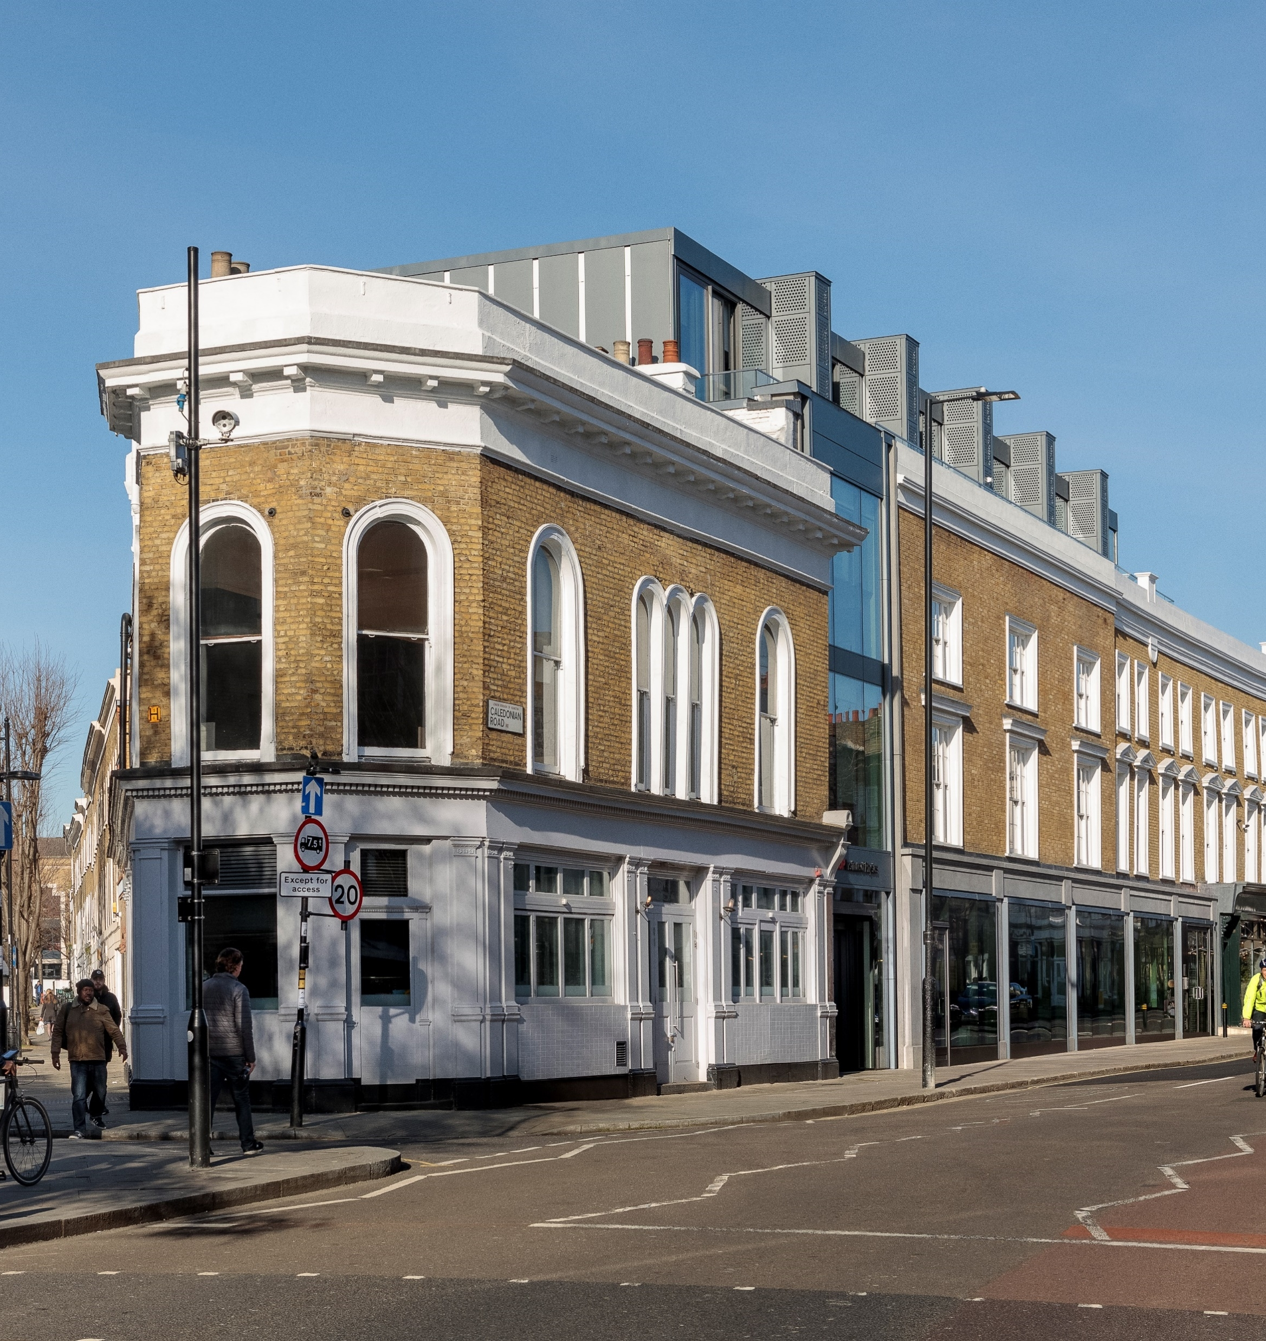
Who are the Institute of Physics?
The Institute of Physics (or IOP for short) is a charity. They love science, especially physics and want to inspire people to love science (especially physics) as well!
They also help people across the UK and Ireland who have studied physics or use it in their job.
Notes:
- Quick show of hands – who has heard of us before today?
- Who has heard of physics before today? Physics is a science, you will have been doing it in school already, even if you haven’t heard the name before. Physics is all about understanding how the world works. Topics like forces, and light and electricity are all physics!

Slide 3
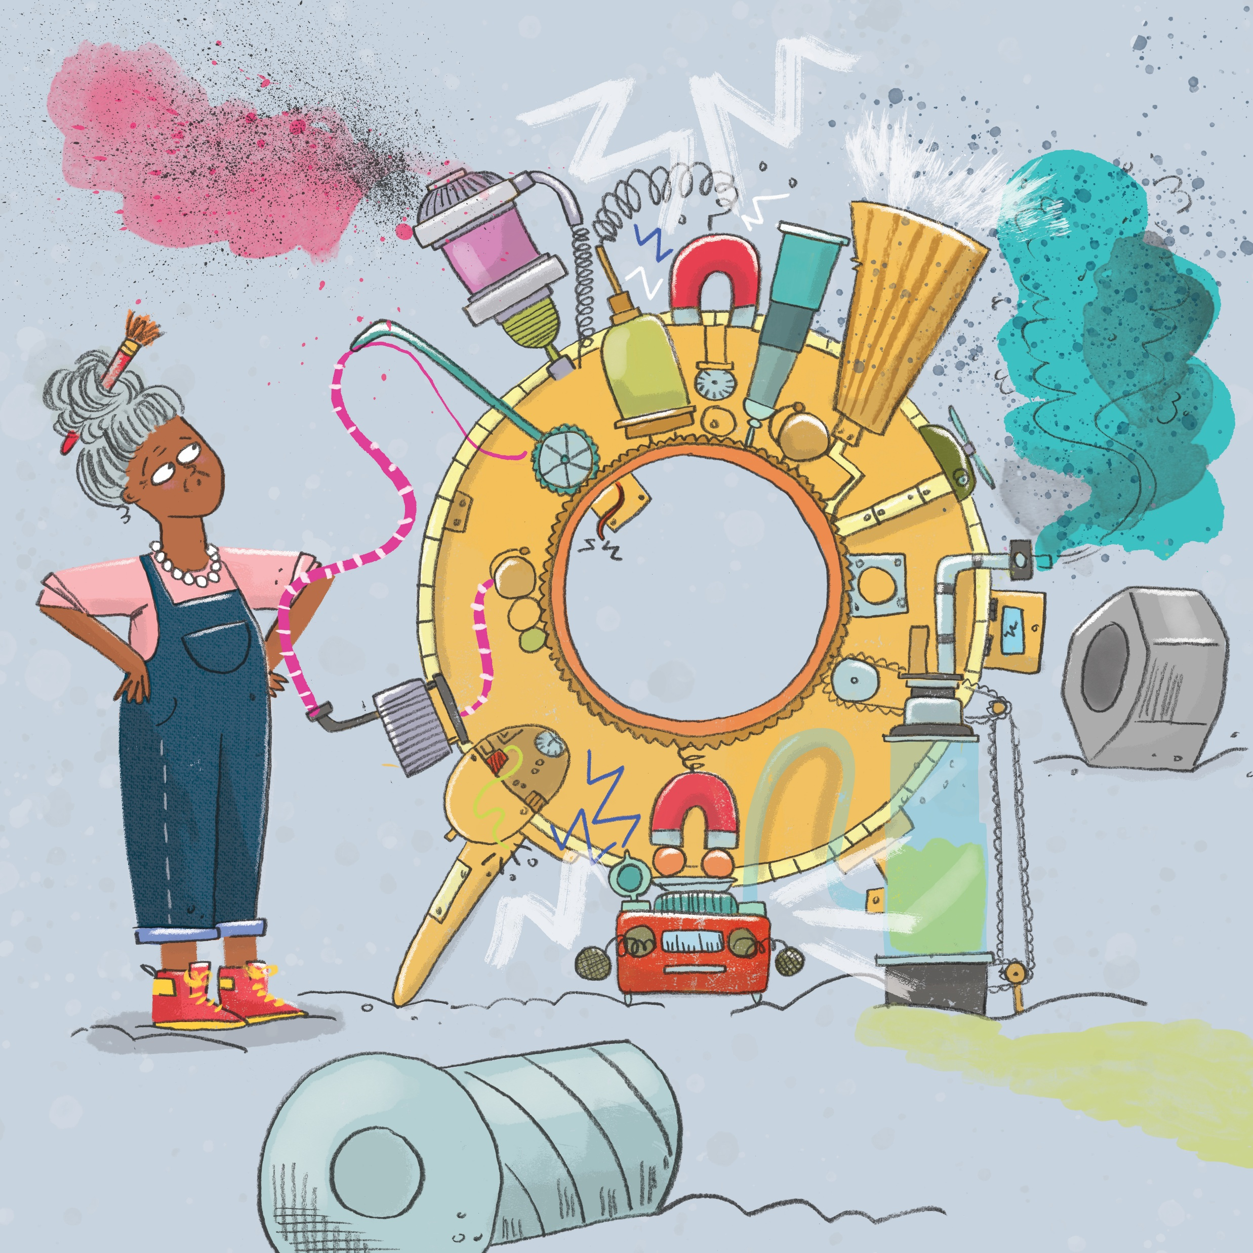
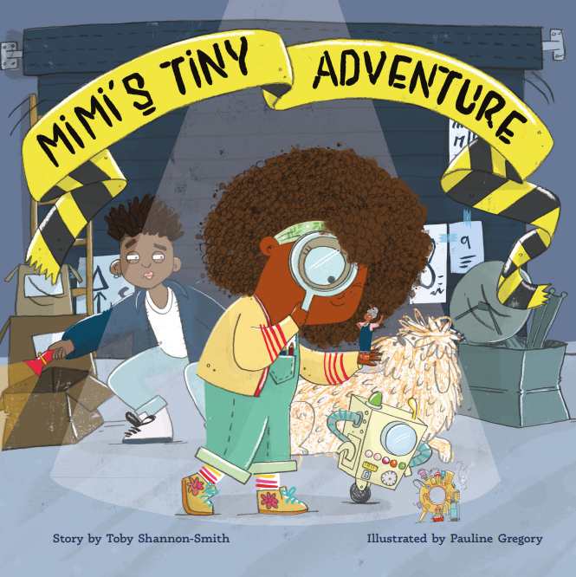
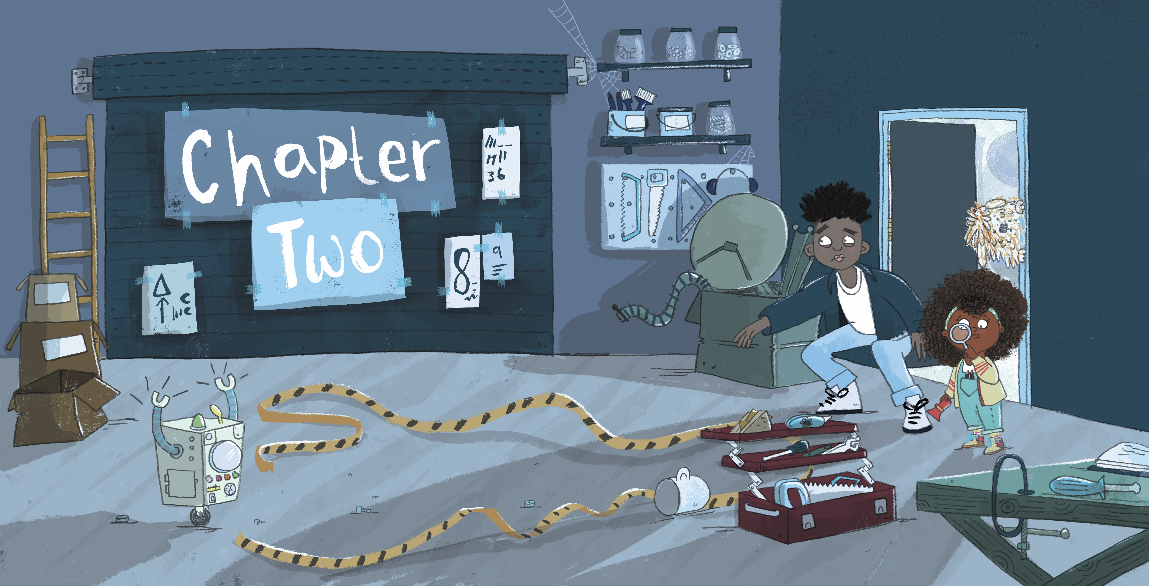
Mimi’s Tiny Adventure
Notes:
Oh no! Granny has had a little accident while building her latest invention, an incredible shrinking machine! She’s now shrunk down to microscopic size and need help from Mimi, her brother Dylan, Colin the Dog and Dave the Robot, to assemble a team of physicists working on the tiny side of science to rescue her.

Slide 4
Over to you - Tiny Questions
1) What is the smallest thing you have ever seen?
2) What is the smallest thing you can think of?
Notes:
ACTIVITY
But first, let’s think about what the smallest thing that you have ever seen with your own eyes is. Think about the question by yourself and write down your answer on a sticky note. Talk to the people next to you – did you think of something similar or different?
Now, think about what the smallest thing you can think of is. Think about it by yourself first. Share with the person next to you.

Slide 5

WHAT IS THAT?
Notes:
ACTIVITY
It’s now time for everyone’s favourite new game show – What is that?!
We have three zoomed in photos things you might know of that were taken by powerful microscope. Your task is to guess correctly what they are.
Are you ready?

Slide 6
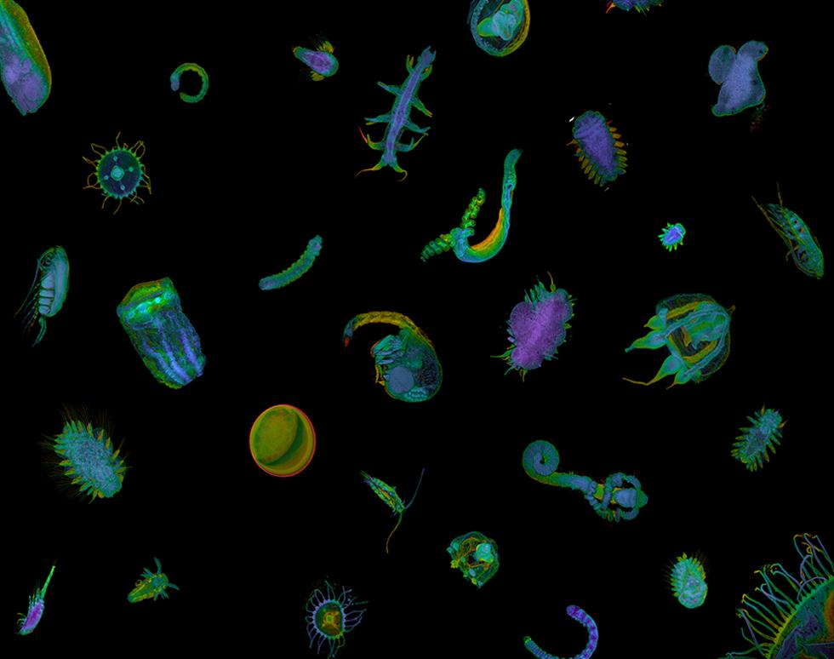

Slide 7
Plankton!

Slide 8
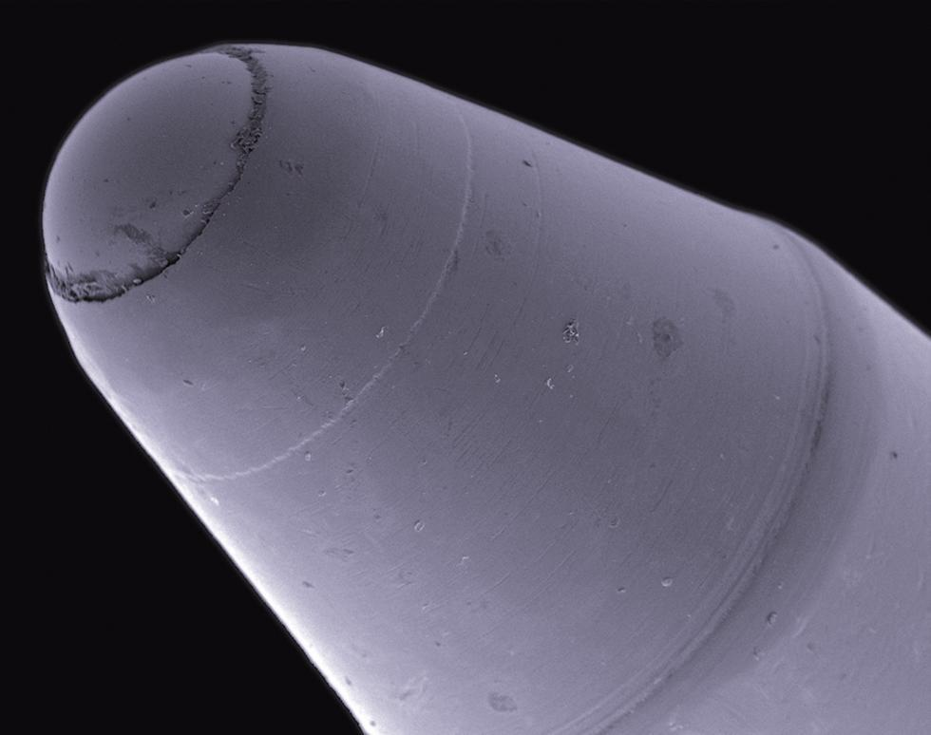

Slide 9
Ballpoint Pen!

Slide 10
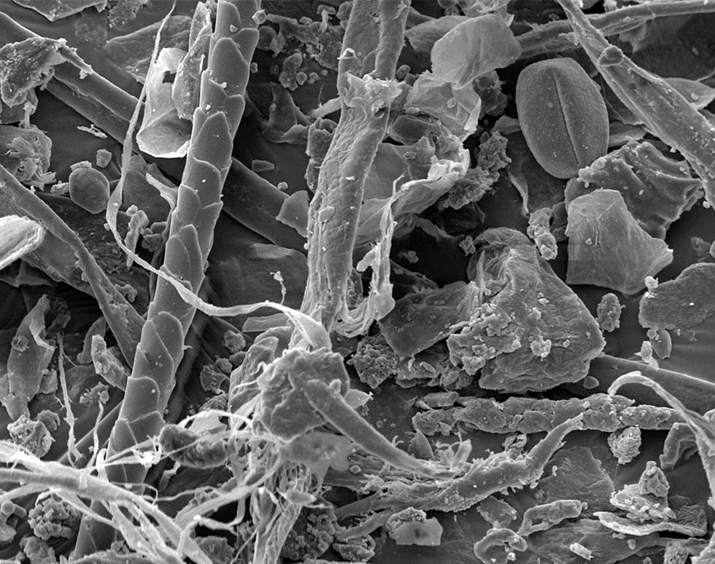

Slide 11
Dust!
Notes:
Dust is made up of lots of little things. Things like, pollen (the coffee bean shaped object in the top right), hair (the long, thin object on the left that goes from the top to the bottom of the picture), bits of thread from clothes (what looks like string on the bottom left) and dead skin (anything that looks like flakes).

Slide 12
Join us for a Tiny Adventure!
Bonus point!
Imogen Thompson and Toby Shannon-Smith
Notes:
Bonus question! What is this? This is an ice crystal on a snowflake.

Slide 13

A tour of the (very, very) tiny…
Notes:
Welcome to a tour of the very, very, tiny. I will be your guide on this journey through the microverse!

Slide 14
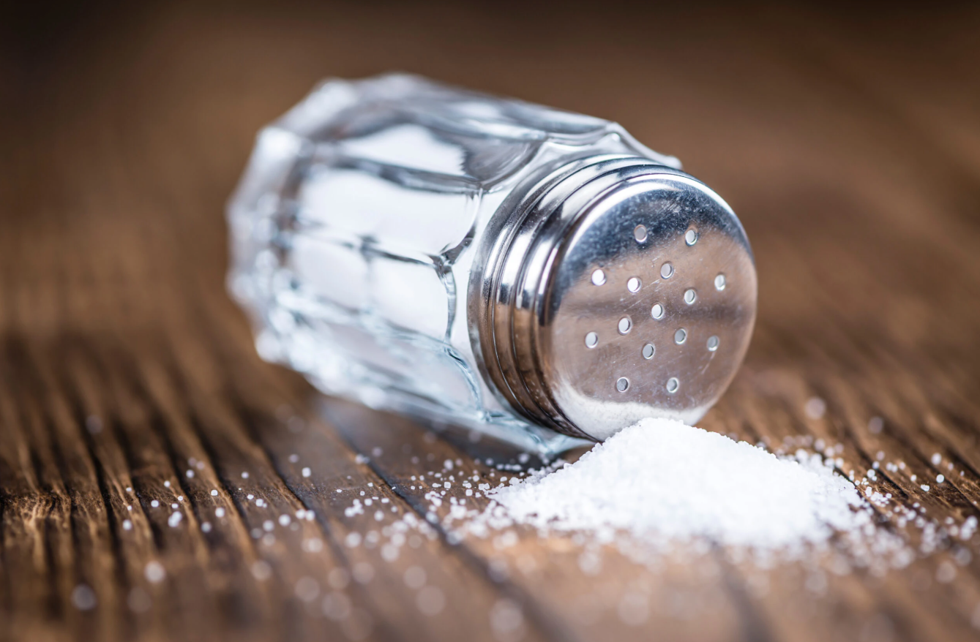
Notes:
Let’s start our journey with this. A single grain of salt is one of the smallest things that our eyes can see. It looks like a little dot to us.

Slide 15
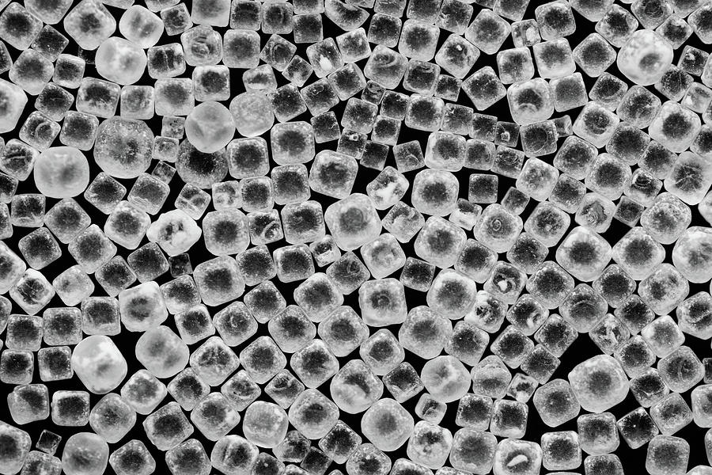
Notes:
But when we use a microscope, we start to see some structure. Salt crystals look like cubes, or boxes.

Slide 16
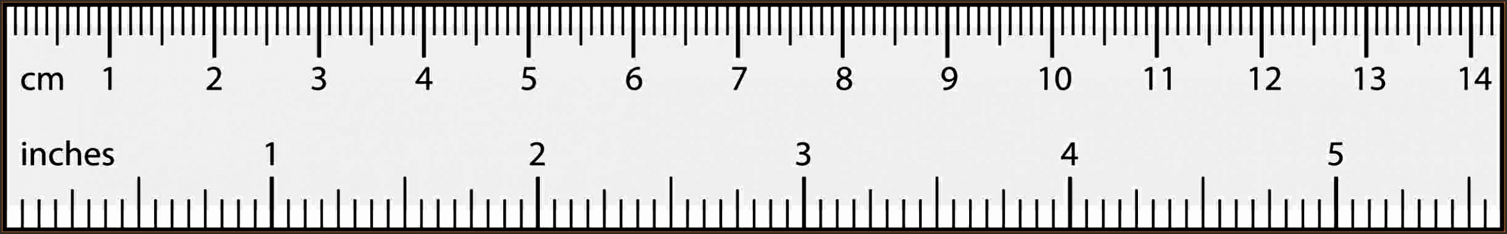
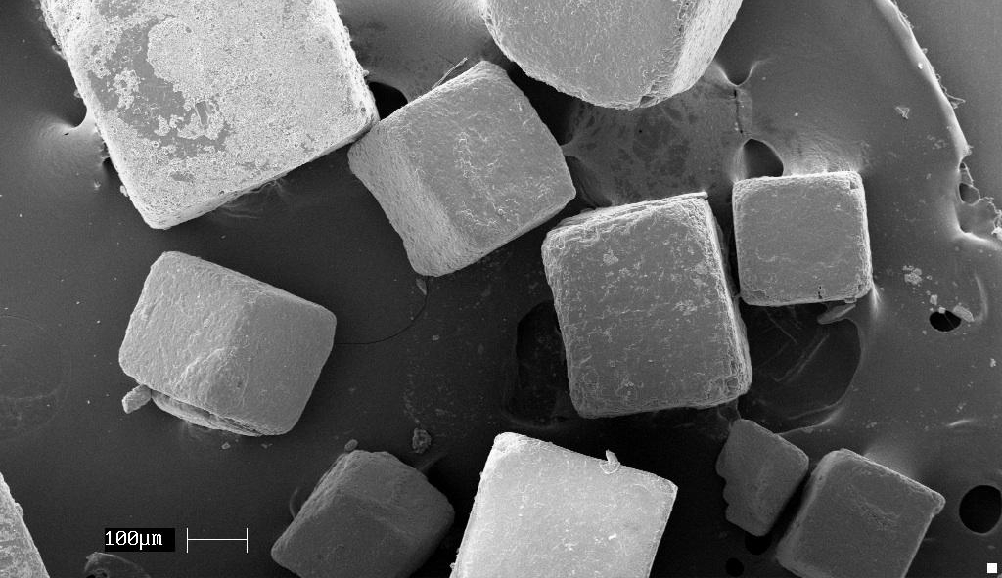
0.3mm!
Notes:
Each “box” is very, very small. The smallest measurement on a ruler is 1 mm. Well, you could line up 3 of those salt boxes side by side to fill 1mm.

Slide 17
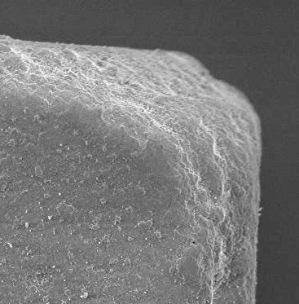
500x bigger than a flu virus!
0.15mm!
Notes:
We’re now looking at one corner of a grain of salt. That is still 500 times bigger than a flu virus!

Slide 18
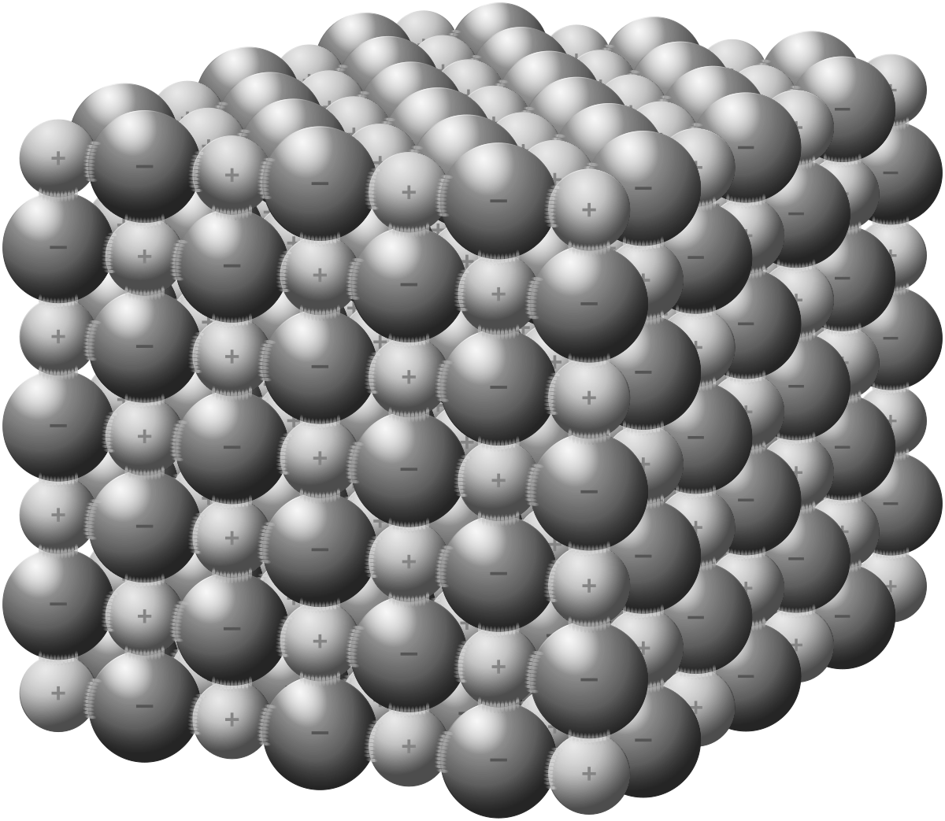
Notes:
If you zoomed in again, then you would see that the salt crystals are made up of atoms. There are about 1 quintillion atoms in a salt crystal! That’s 1 with 18 zeroes after it. That’s about a trillion times more than the number of stars there are in the Milky Way galaxy!

Slide 19
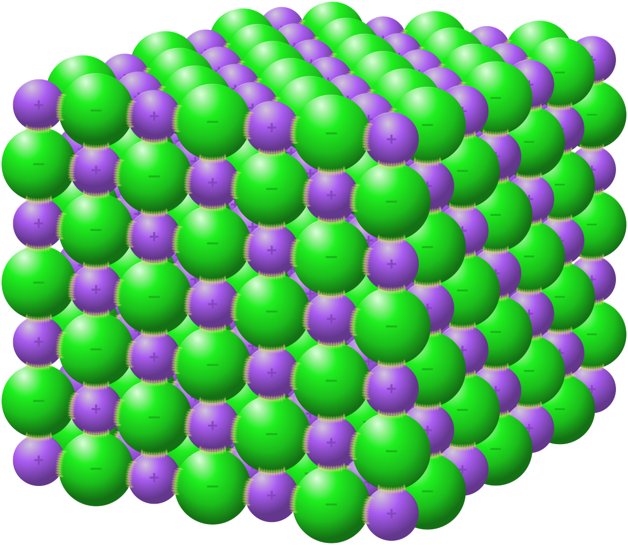
0.000001mm!
A molecule!
Notes:
Salt is made up of two different types of atoms – sodium and chloride atoms. When you join two different types of atoms together, you get a molecule. The molecules in a salt crystal are neatly arranged in a cube, which gives the salt crystal their cuboid shape.

Slide 20
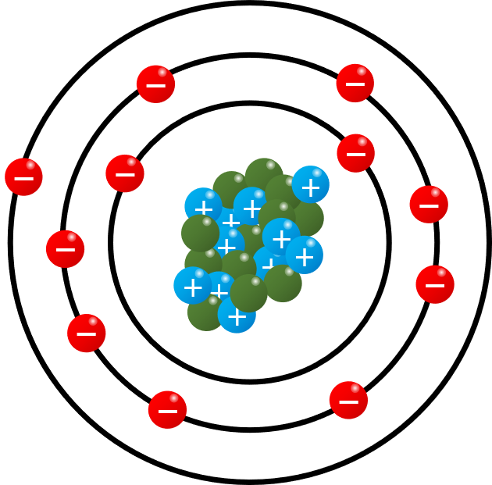
An atom!
Notes:
Zoom in even more, then you’ll start to see particles – protons, neutrons and electrons. Protons and neutrons make up what’s called the nucleus. Around the nucleus, you’ll find electrons. The nucleus is very, very small compared to the size of the whole atom, which are already tiny.
Protons, neutrons and electrons are called particles.

Slide 21
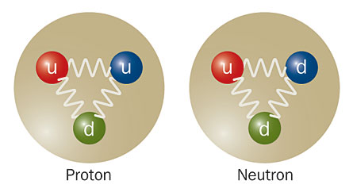
1 proton is 0.000000000000001mm across!
Electron!
What’s inside an atom?
Notes:
But protons and neutrons are made up of even smaller particles called quarks.
[quarks is pronounced kwarks]

Slide 22
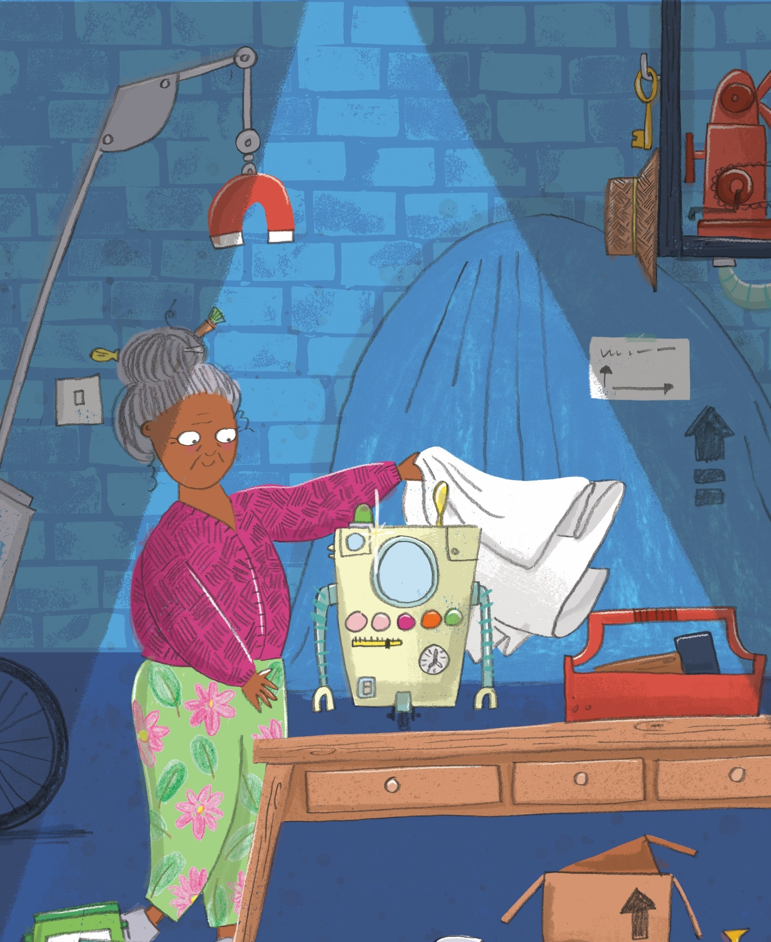
Mimi’s Tiny Adventure
To rescue granny, Mimi and the team have four challenges:
Work out how big granny is
Work out where she is!
Find a way to communicate
Find a way to make tiny tools
The story is a fiction book, but these challenges all have their roots in real physics

Slide 23

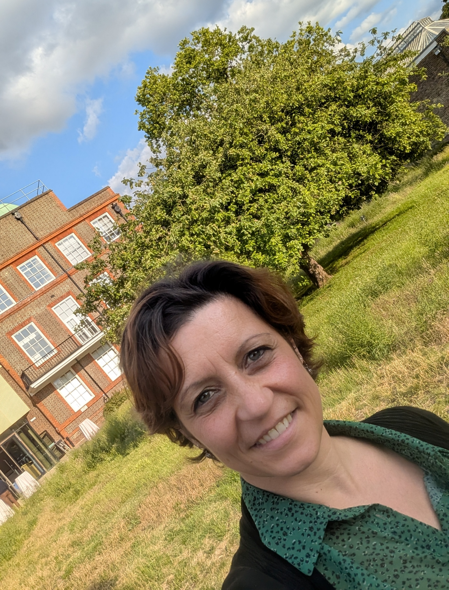

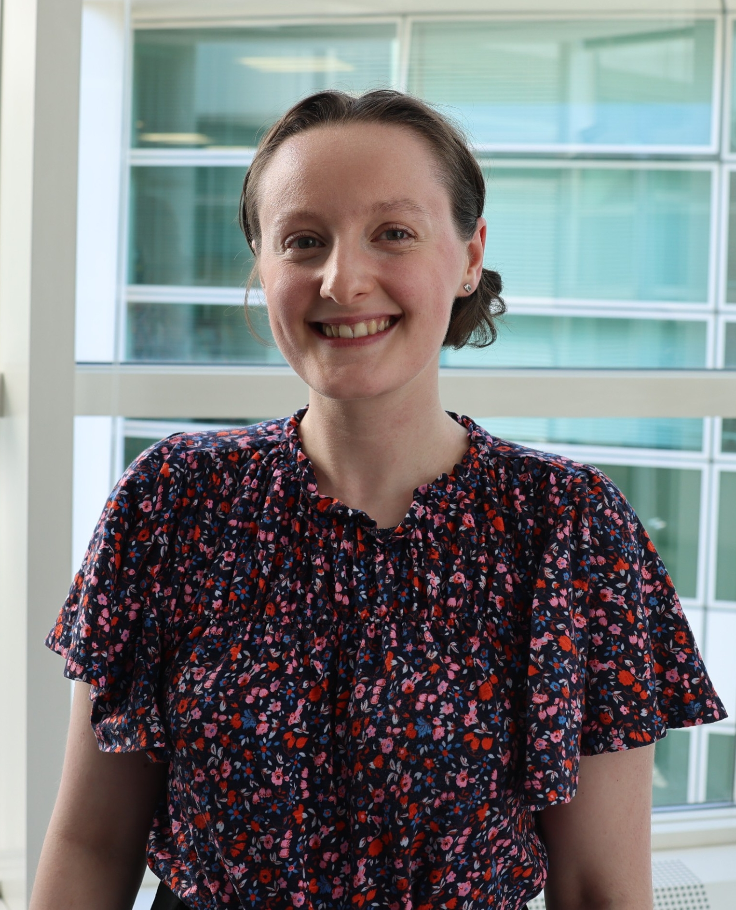
Tiny physics. Real jobs.
Challenge 1: How big is granny?
The science is all about measuring something too small to see, a bit like our microscope gameshow.
A measurement scientist is called a ‘Metrologist’. They use incredible equipment like microscopes to explore this tiny invisible world.
There is a National Metrology Institute totally dedicated to more and more high-tech ways to measure.
Notes:
The photos at the bottom are real physicists whose jobs are related to the challenges that Mimi and her friends have to overcome. You can find out more about these scientists by reading their profiles on the role model posters or on here Mimi’s Tiny Adventure: physics role models | Institute of Physics
Pictured here are Caterina, Torin and Jodie

Slide 24
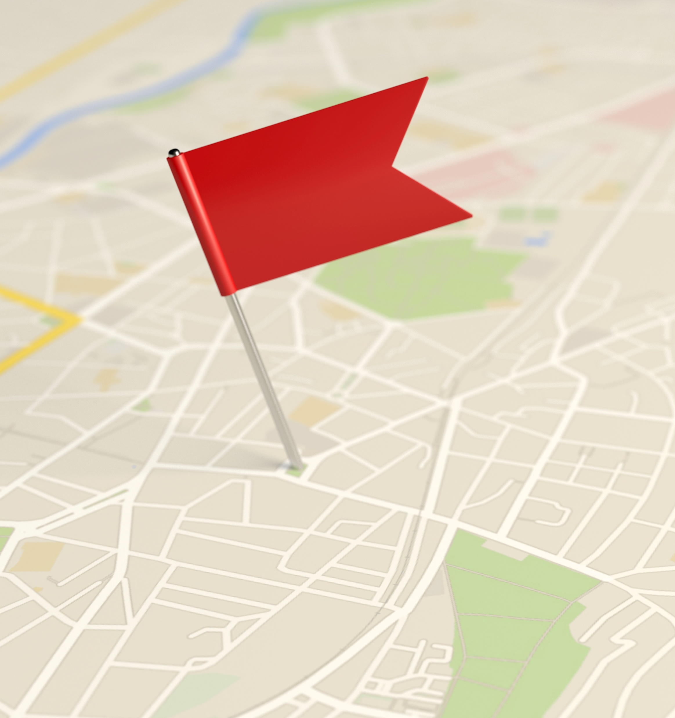
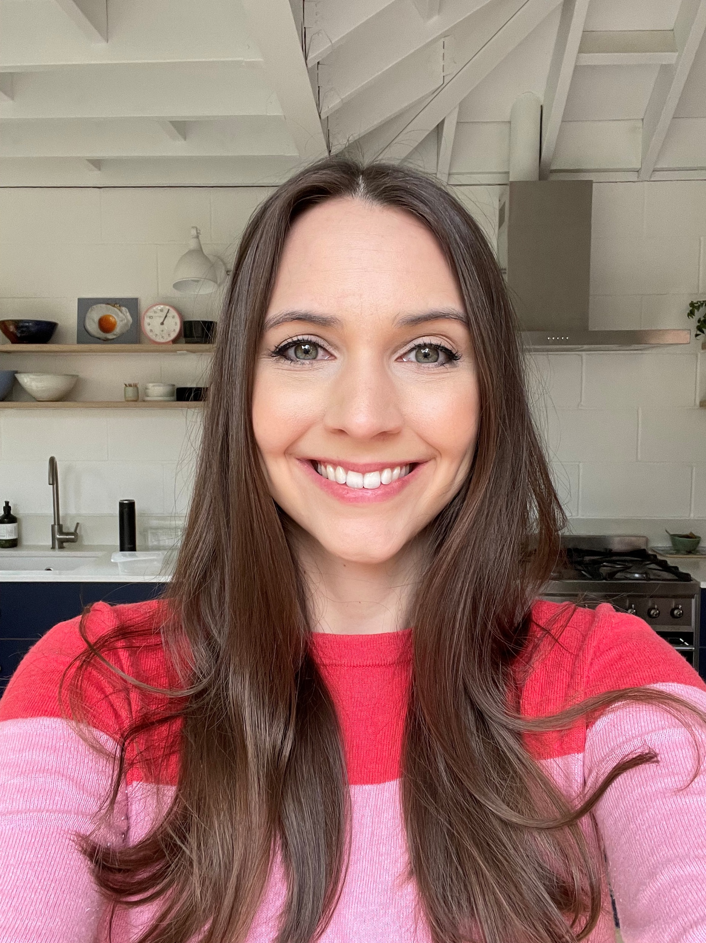
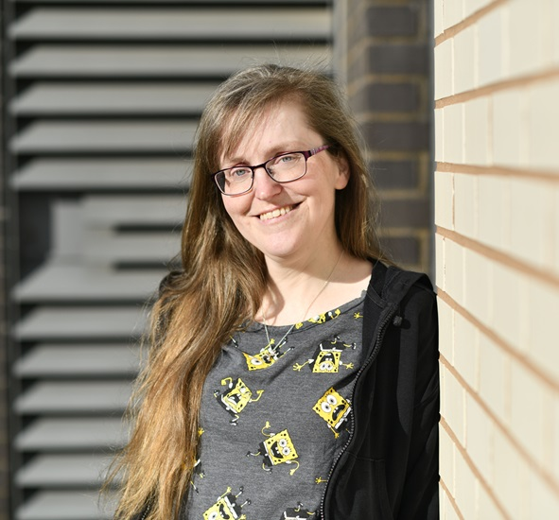
Challenge 2: Where is granny?
Knowing where something is, is really useful, especially in medical physics. Medical physicists help doctors and do things like take pictures inside the body, discovering how new medicines work or the best ways to find and treat cancer cells.
There is a brand new technique, invented in Birmingham University, where medical physicists should be able to keep track of where a single particle is, anywhere in the body, in real time.
Notes:
The scientists on this slide are Kirsten and Rachel

Slide 25
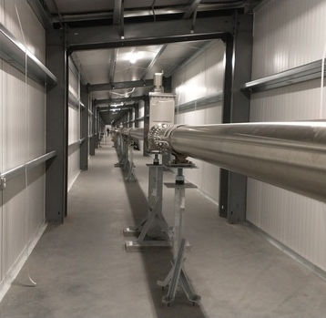
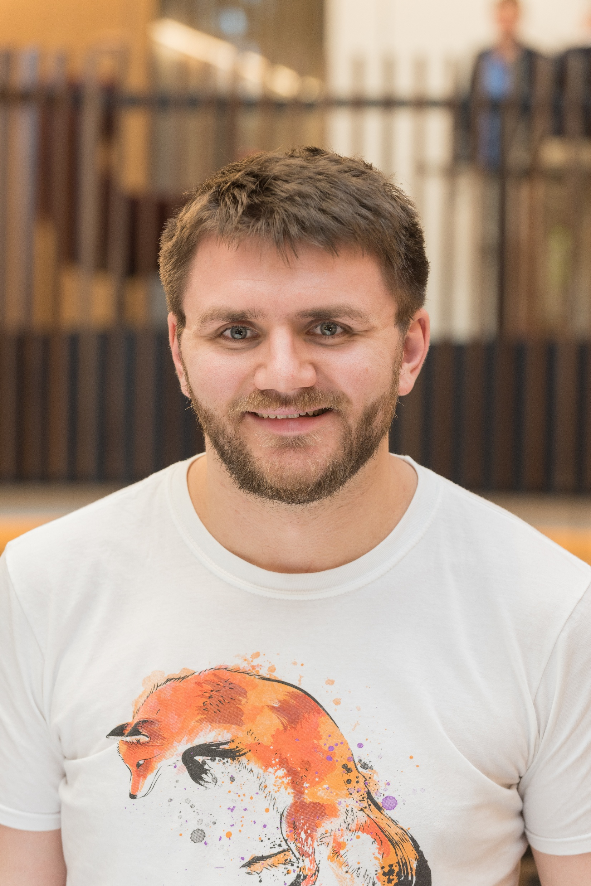
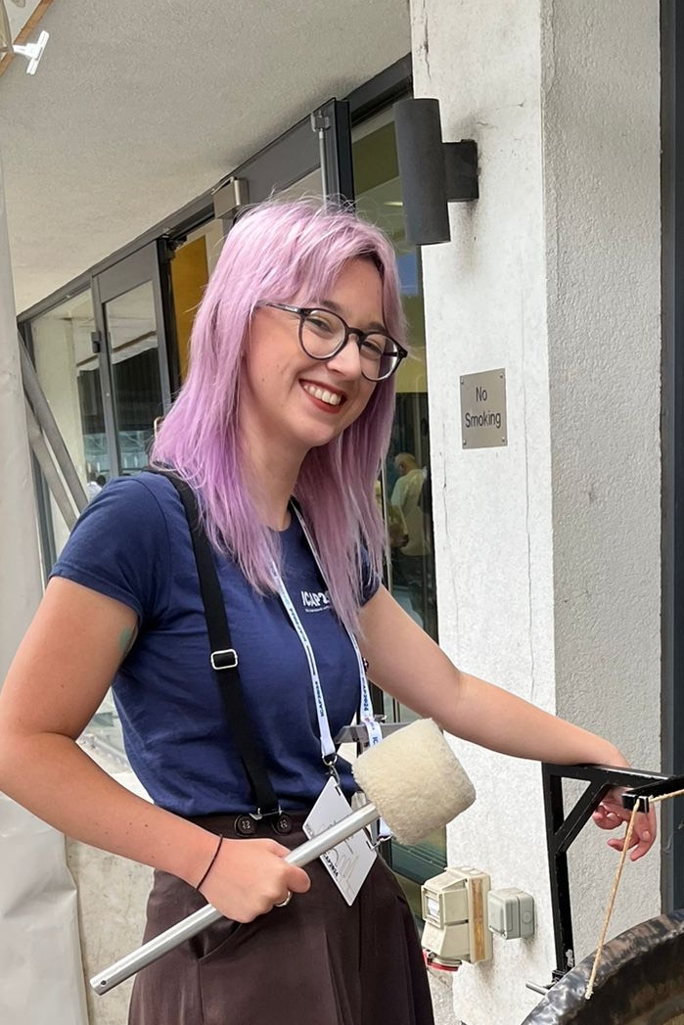
Challenge 3: Detecting tiny signals, communicating with granny
To detect tiny signals, you normally need a BIG experiment. Some of the smallest signals in the universe come from Gravitational waves, and we need a detector that is miles long to be able to sense them.
Physicists called “gravitational wave astronomers” use these use these massive experiments to try to find out more about our universe by tracking where in space the signals have come from.
Notes:
Here we have Thomas and Bryony

Slide 26
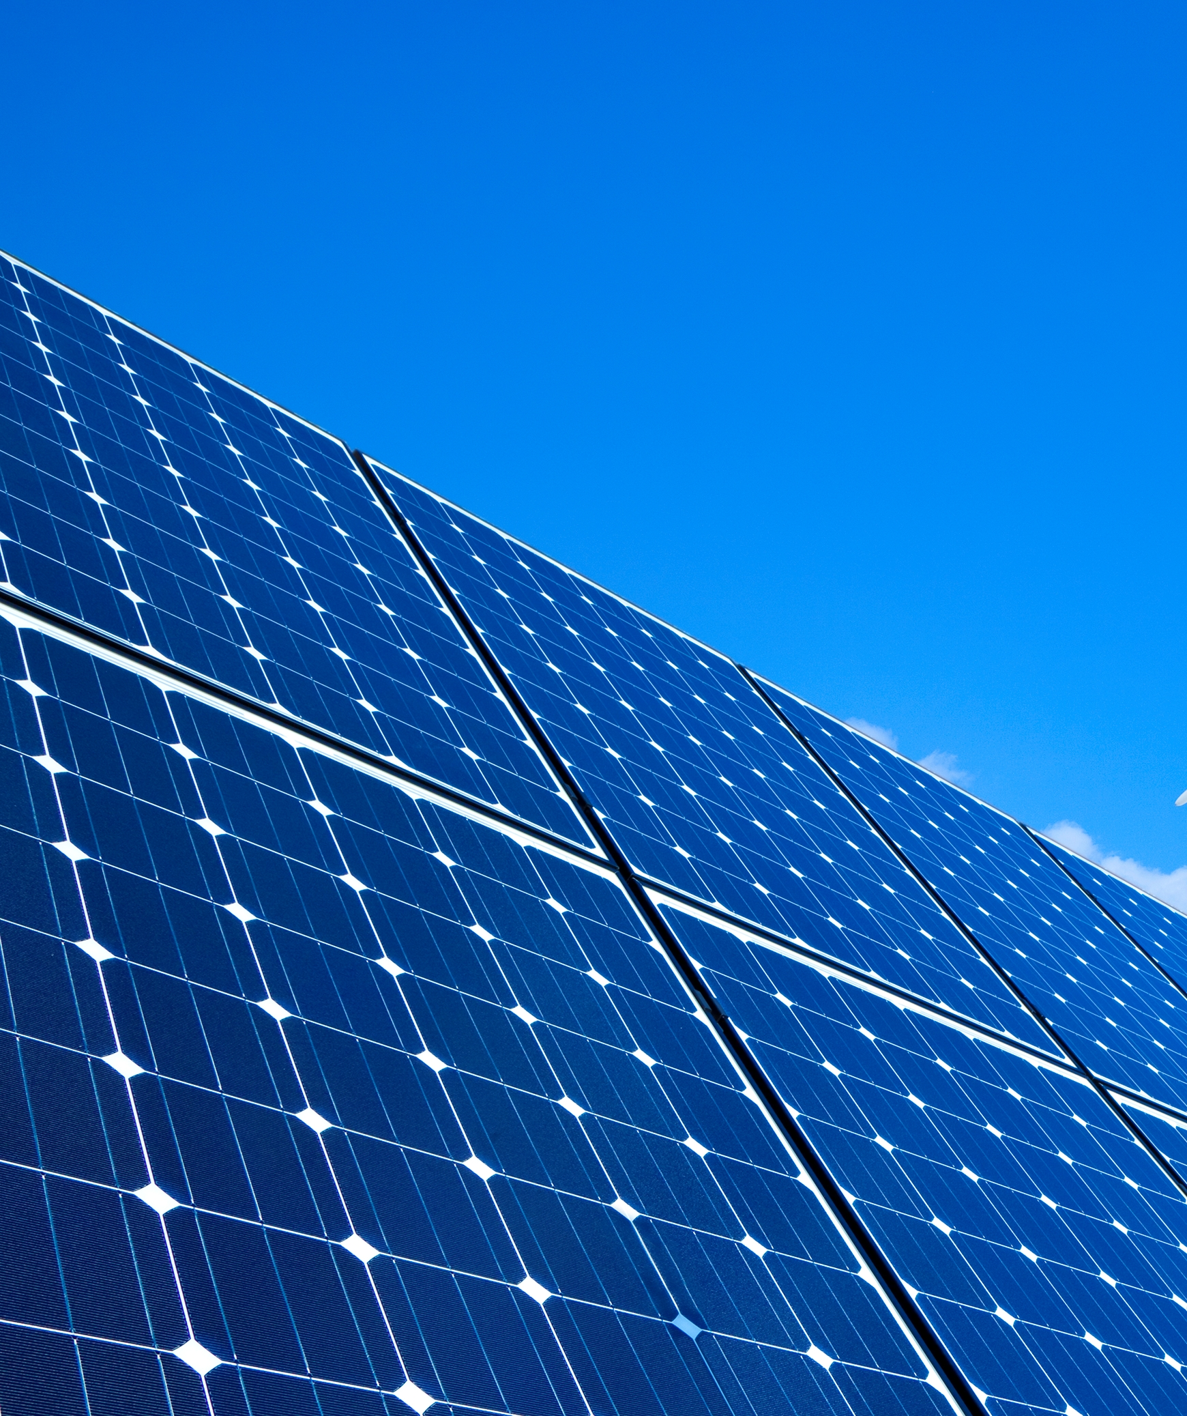
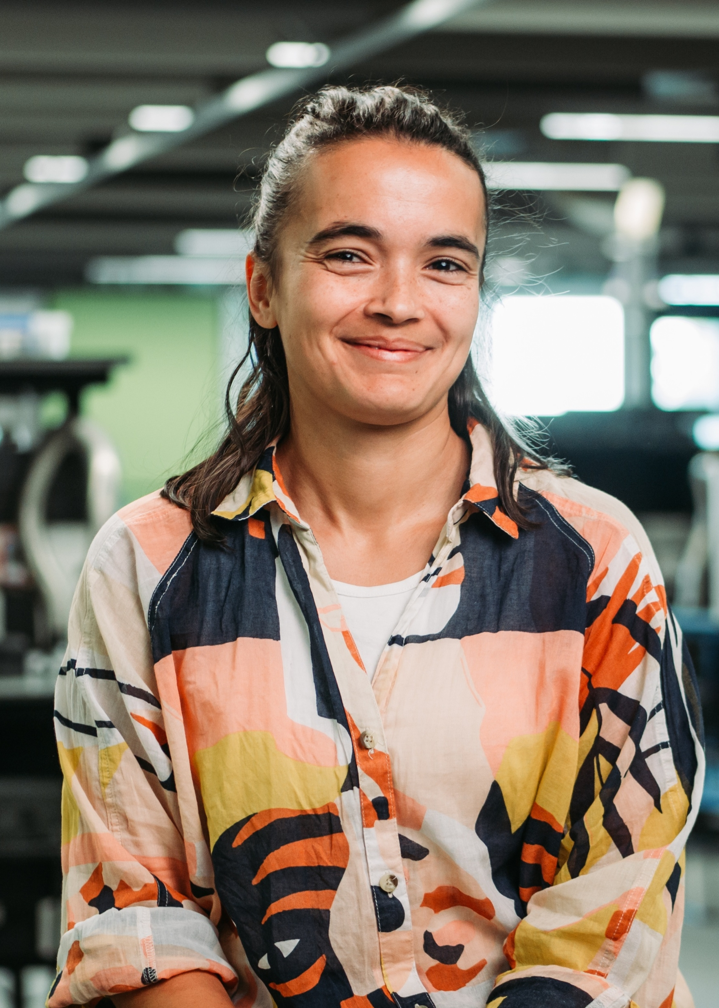


Challenge 4: Making Tiny Tools
Granny needs tiny tools to fix her machine, and these tiny tools are being invented in real life too!
Nanotechnology is technology only a few billionths of a meter across! This tiny tech could be a big part of the future with inventions helping medicine, electricity generation, and for future transport and computing systems.
Physicists have been working on new lightweight and flexible solar panels using nanotech, which could help us generate more green energy than ever before.
Notes:
Maddison, Armando and Rachel all build tiny things in real life as part of their jobs

Slide 27
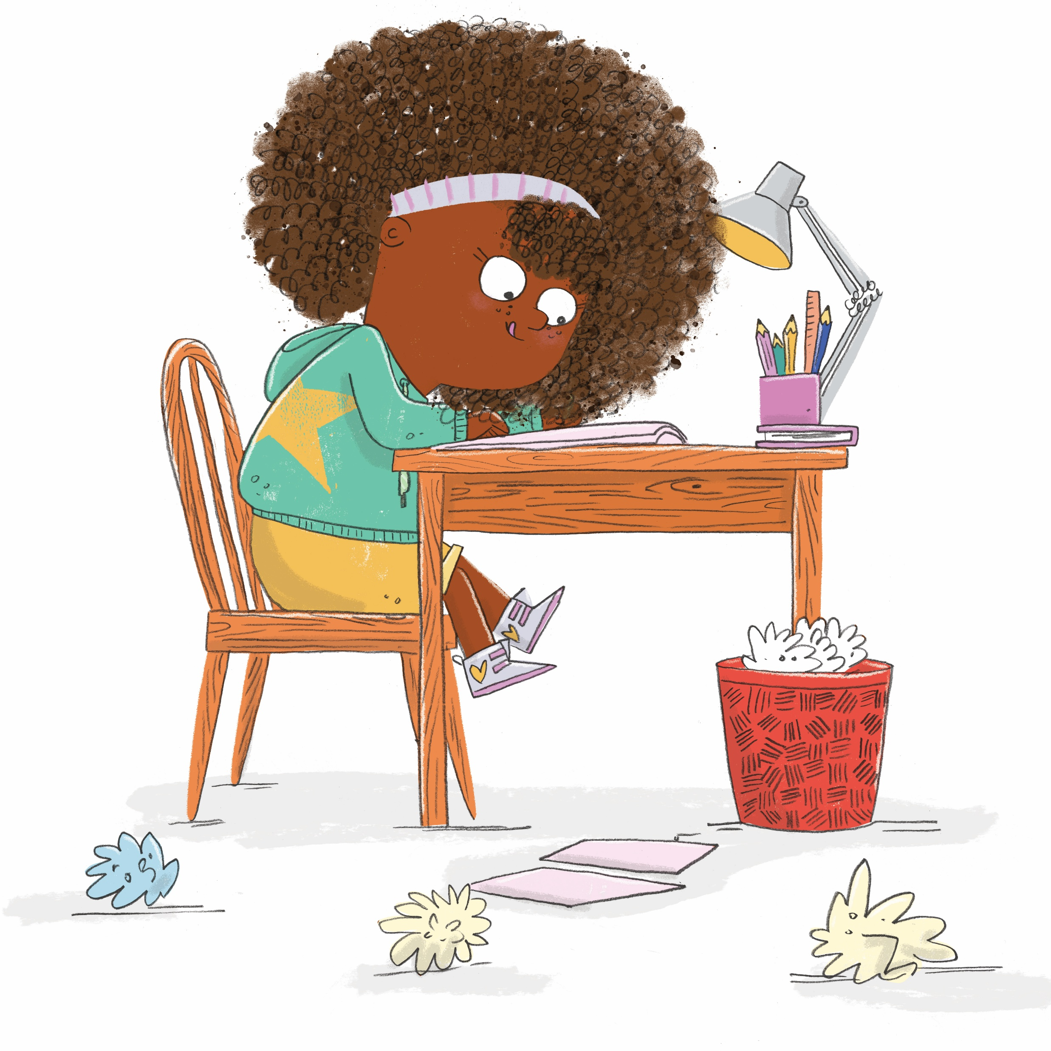
Make your own Tiny Adventure book
Design your inventing space
Design your shrinking machine
You’ve shrunk yourself down to microscopic size! What can you see?
Notes:
ACTIVITY
You will need to print the ‘Zine template’ and ‘Zine instructions’ pdfs for this activity.
The time has now come for you to make your own Tiny Adventure book. You will first need to design your inventing space – is it a garage, a lab, or maybe even your bedroom? Then you will need to design your shrinking machine. What does it look like? Your machine has worked and shrunk you down to microscopic size! What can you see around you?

Slide 28

Any Questions?

