Slide 1

Adapting Practice in context: Embedding Practical work for an Increasingly Diverse Cohort
Rob Campbell
Course lead PGCE Science
robert.campbell@stmarys.ac.uk
With Thanks to
Charlie Anderson, Diocese of Westminster Academy Trust- Director of Secondary Improvement
Jess Rowson, Ogdon Trust
Dan Cottle, Assoc Prof Physics Education, University of Birmingham

Slide 2
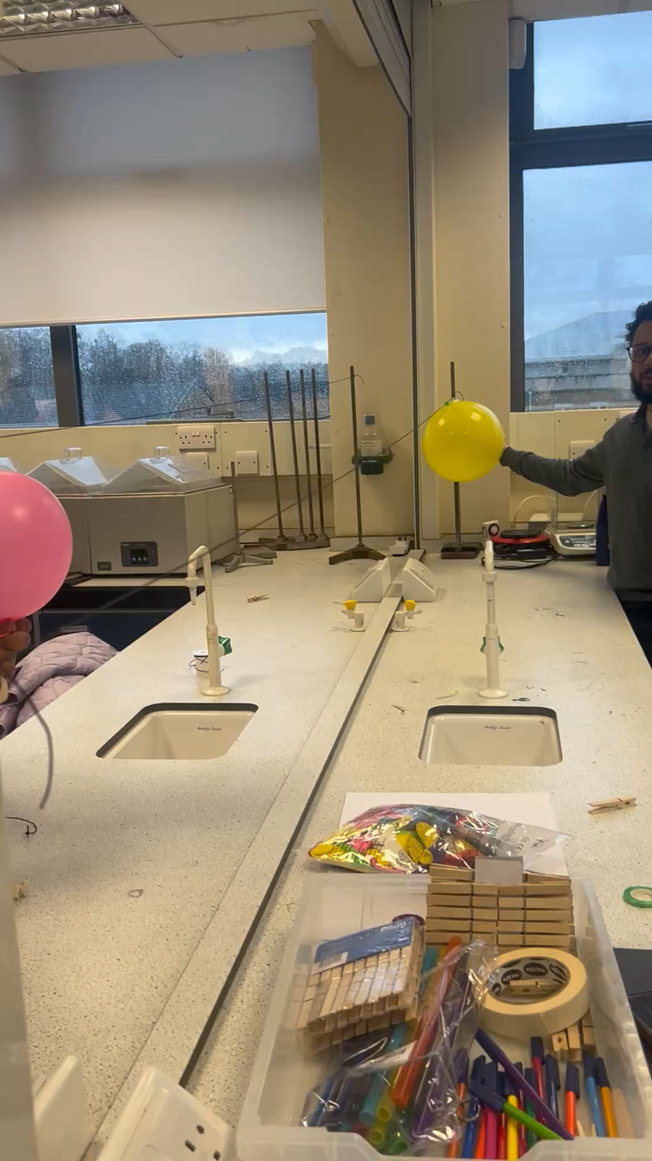
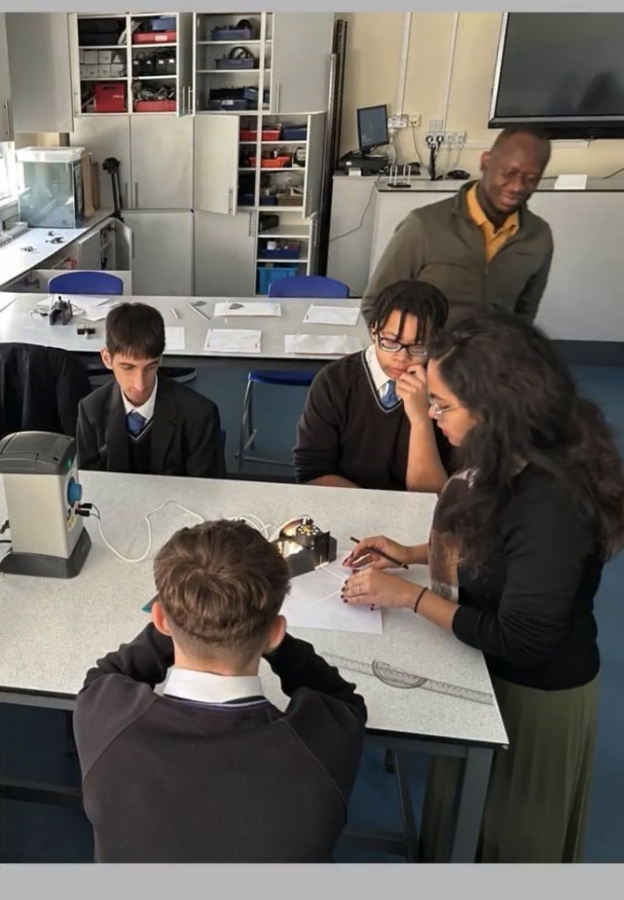
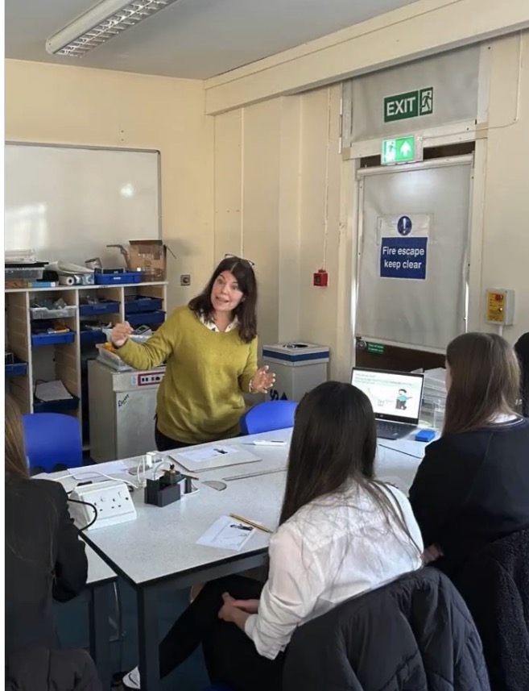
Our approach to practical work
University-led Sept-Dec
University partner school collaboration Jan
University partner school collaboration (Jan)
School placement led (April/May)
6 x discipline-specific practical sessions
Pupils work in groups. Each group has at least 1 specialist
Pupil practical day- teaching underachieving year 10
Pupil practical day- SEND partner schools
Task to complete practical work in a school placement and subsequent reflection

Slide 3


A changing demographic
Deficit approach
English Physics teacher education
Academic year | Number of physicist | Percentage of whom are international
2022-2023 | 7 | 29%
2023-2024 | 10 | 70%
2024-2025 | 27 | 93%
2025-2026 | 33 | 100%
Human
approach
Notes:
Initially a defi

Slide 4
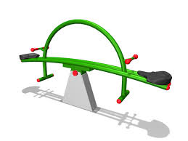
Restructuring a deficit approach
Support non-specialists develop an understanding of physics
Support international physicists become familiar with novel scientific equipment
Notes:
Slide 3, we use it to inform our study.
We met as a team and we grouped the critical friend to delve deeper into our discomfort and tensions.
We use this framework from O'Dwyer to meet individually as a group and then separately bring in our critical friend to help us delve deeper into our emerging tensions and help us understand how as a group

Slide 5
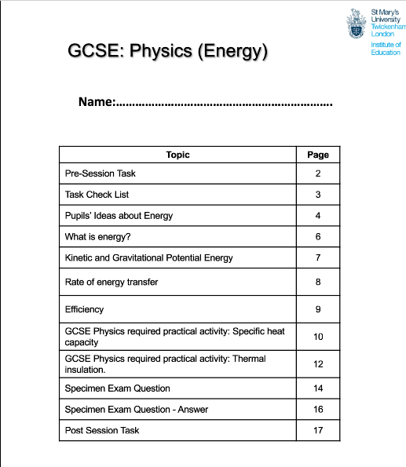
Restructuring a deficit approach
Practical sessions have a discrete focus based on common misconceptions In physics, this is
Energy – focus on why reviewing language in energy stores/transfers is helpful
Forces
Electricity
Align with BEST resources – focus on misconceptions
Redress the fear in physics and support familiarisation

Slide 6
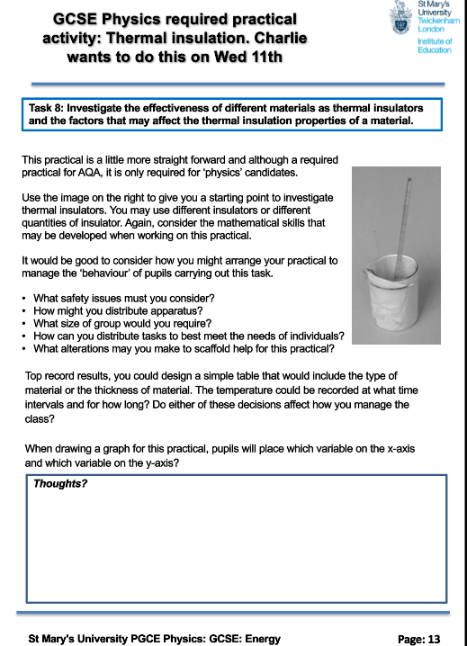
Restructuring a deficit approach 2
Exposure and formulaic approach
Practical days have an overarching theme (content focus)
Round robin of activities
Consistent expectations
Working scientifically skills covered
Apparatus and technique skills covered
Method – introducing unfamiliar equipment
H&S
Results
BEST diagnostic question and group discussion

Slide 7
Impact- PST voice
Specialism
Home physics specialist | The trolley exercise to record speed/acceleration helped familiarise the setup and the health and safety rules surrounding them. This was directly useful in classes, I am someone who enjoys doing things with my hands and jump in, this is totally different to students abilities who I am teaching and they require the necessary associated forms and sheets to conduct safely.
International biology specialist | Rob and Charlie help me to build Confidence By breaking and fixing circuits in a safe environment, I overcame the anxiety of live demonstrations, making me appear as the expert in the room.
Home Chemistry specialist | They were a great reminder of the actual practicals before we run them in class - especially all the ways they might go wrong! Also a good way to help us embed our theory.
International Physicist | As a physicist, Rob and Charlie’s deliberate use of practicals supported my development as a teacher by modelling how hands‑on work can be used strategically to strengthen conceptual understanding rather than simply confirm theory. Their practicals demonstrated how experiments can diagnose misconceptions, scaffold abstract ideas and promote scientific thinking.
Diagram from: O’Dwyer, A., Bowles, R. and Ní Chróinin, D., 2019. Supporting collaborative self-study: An exploration of internal and external critical friendships. Studying Teacher Education, 15(2), pp.139-159.
Notes:
Slide 3, we use it to inform our study.
We met as a team and we grouped the critical friend to delve deeper into our discomfort and tensions.
We use this framework from O'Dwyer to meet individually as a group and then separately bring in our critical friend to help us delve deeper into our emerging tensions and help us understand how as a group

Slide 8
The revision continues
Academic year | biology | No with previous teaching experience | Chemistry | No with previous teaching experience | physics | No with previous teaching experience
2025-2026 | 8 | 4 | 8 | 2 | 29 | 27
2026-2027 | 3 | 0 | 6 | 5 | 54 | 35
% international 2025-2026 = 73% all physics 1 in chem 3 in bio
% international 2026-2027 – 91% (entire physics cohort and 2 in chem)

