Slide 1
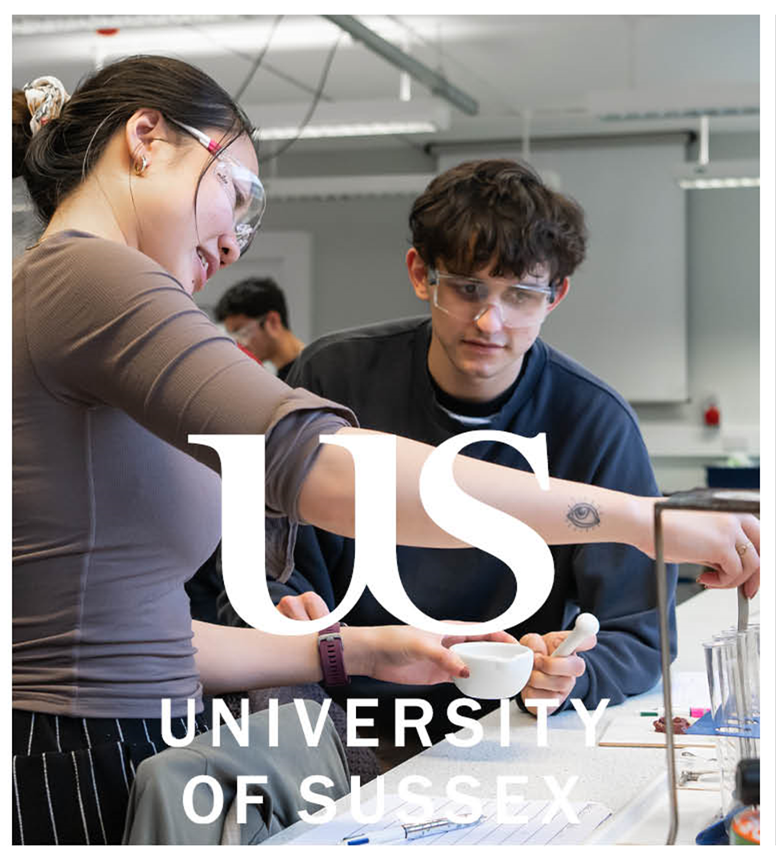
Supporting Neurodivergent Science ITE Students – A Case Study as a Placeholder
Susie d’Espagnac
Assistant Professor in Science Education
sc2003@sussex.ac.uk
Notes:
Bit of background – teacher for 10 years, mentor for 8 years, working in ITE for 4 years

Slide 2


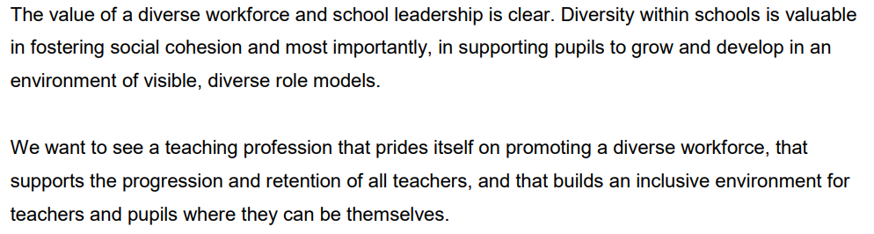
(Department for Education, 2018)

Slide 3
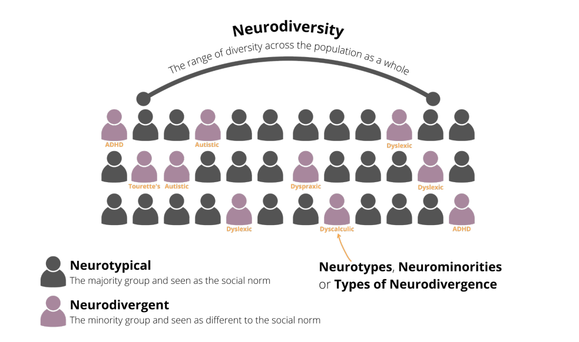
Neurodiverse vs Neurodivergent
(Farr, 2022)

Slide 4


Context – Neurodivergence in STEM
The number of STEM students at UG and PG level with a known disability doubled between 2007-2018 (15.5% and 12.5% respectively)
There is variation between degree subjects (e.g. Biology and Physics) and gender
79.1% of STEM first degree students reporting a social communication/autistic spectrum condition are male
It is estimated that on average around 15% of the general population are neurodivergent (NHS England, n.d)
(Joice & Tetlow, 2021)
Notes:
This year, of the 5 diagnosed student teachers, 3 are physics specialists

Slide 5
Context – Our Science Cohorts at Sussex
It is estimated that on average around 15% of the general population are neurodivergent (NHS England, n.d)
Year | Students with Learning Support Plan | Other – self-diagnosed, pending, did not declare | Total
2021-22 | 9% (ADHD, ASC, Dyslexia) | 19% (ASC, ADHD) | 28%
2022-23 | 11% (ADHD) | 22% (ASC, ADHD) | 33%
2023-24 | 26% (ASC, ADHD, Dyslexia, Dyscalculia) | 13% (ADHD, ASC) | 39%
2024-25 | 21% (ADHD, ASC, Dyslexia) | 29% (ADHD, ASC) | 50%
Notes:
This year, of the 5 diagnosed student teachers, 3 are physics specialists

Slide 6


Literature
Many students in Higher Education do not disclose their learning needs (Eccles et al., 2018).
History of teachers and support staff citing a lack of support for their specific needs as a reason for leaving their jobs, and this has also been the case for some student teachers whose needs are not met during their training year (Wood et al., 2022; Wood & Happé, 2023).
The nature of the school environment – busy, loud, social and sometimes unpredictable can be difficult to navigate for neurodivergent people, often resulting in anxiety, masking, fatigue and burnout (Wood & Happé, 2023).
Quite often what we think we know about a specific need is based on stereotype derived from observations from individuals who lack lived experience (Gillespie-Lynch et al., 2017).
Intersections and comorbidity among needs (Hours, Recasens & Baleyte, 2022).

Slide 7


Challenges
Negative stereotypes and deficit model of diagnosis can result in low-expectations which have a negative impact on neurodivergent teachers (StEvens, 2022).
Late diagnoses, no diagnosis, self-diagnosis coupled with fear of sharing a diagnosis means needs are often not being met (Wood & Happé, 2023).
How student teachers respond to critical incidents related to their identity depends on the context and how safe they feel (Vickers-Hulse & Whitehouse, 2023).
Support during PGCE falling away for ECT – set up for failure? Realistic view of the profession? (Pesonen et al., 2020).

Slide 8

Successes
Neurodivergence ≠ deficit
Skills useful in science/science teaching e.g.
  Dyslexic people often excel in lateral thinking, visual awareness, spatial reasoning and holistic problem-solving (Herr, 2021).
  People with ASC are often good at spotting errors which others my overlook and can have the ability to maintain intense focus (Fabri, Andrews and Pukki, 2016).
  Neurodivergent individuals show empathy and inclusion of pupils with additional needs though innovative teaching methods born of their own educational experiences (Wood & Happé, 2023).

Slide 9


Recommendations
Clear expectations, opportunity to share needs, reasonable adjustments and regular reviews.
There is no one-size-fits-all approach.
Use of assistive technology and AI.
Positive neurodivergent role models in teaching (StEvens, 2022), through mentoring and buddy systems both in school and at university.
Providing safe spaces without being tokenistic (Vickers-Hulse & Whitehouse, 2023).

Slide 10


Case Study Examples – Beyond Academic Support
Student teacher with ASC required a “bolt hole” in school – a place to go to when feeling overwhelmed.
Student teacher with ASC would sit alone during university sessions.
Mentor with dyslexia for a student teacher with ADHD uses voice recording software when giving feedback.
University tutor supporting student teacher with ADHD to organise timetable and access student support.

Slide 11

Moving forward – working together
University of Sussex
Bath Spa University
Leeds Beckett University
ASE
IOP
Schools
You!
Please feel free to add your ideas, comments, questions and suggestions.
Susie d’Espagnac
Assistant Professor in Science Education
sc2003@sussex.ac.uk

Slide 12
References and Further Reading
Department for Education (2018) Statement of intent on the diversity of the teaching workforce – setting the case for a diverse teaching workforce Available at: https://www.gov.uk/government/publications/diversity-of-the-teaching-workforce-statement-of-intent (accessed 7/12/23)
Eccles, S., Hutchings, M., Hunt, C. & Heaslip, V. (2018) Risk and stigma: studnts’ perceptions and disclosure of “disability” in higher education, Widening Participation and Lifelong Learning, 20(4), pp.191-208
Fabri, M., Andrews, P.C.S. and Pukki, H.K. (2016) A guide to best practice in supporting higher education students on the autism spectrum – for HE lecturers and tutors. UNSPECIFIED, pp.1 - 28 (28).
Farr, L. (2022) Guide to Practice-Based Learning (PBL) for Neurodivergent Students, available at https://www.hee.nhs.uk/sites/default/files/documents/Guide%20to%20Practice-Based%20Learning%20%28PBL%29%20for%20Neurodivergent%20Students.pdf (accessed 27/4/25)
Gillespie-Lynch, K., Kapp, S. K., Brooks, P. J., Pickens, J., & Schwartzman, B. (2017). Whose expertise is it? Evidence for autistic adults as critical autism experts, Frontiers in Psychology, 8, p.438.
Herr, O. (2021). Dyslexic? No problem! [online] British Science Association. Available at: https://www.britishscienceassociation.org/blog/dyslexic-no-problem. (accessed 27/4/25)
Hours, C., Recasens, C. & Baleyte, J.M. (2022) ASD & ADHD Comorbidity: What are we talking about, Frontiers in Psychiatry eCollection
Joice, W. and Tetlow, A. (2021). Disability STEM data for students and academic staff in higher education. Available at: https://royalsociety.org/-/media/policy/topics/diversity-in-science/210118-disability-STEM-data-for-students-and-staff-in-higher-education.pdf (accessed 28/4/25)
NHS England (n.d) Workforce, training and education, available at https://www.hee.nhs.uk/our-work/pharmacy/transforming/initial/foundation/resources/edi/neurodiversity (accessed 27/4/25)
Pesonen, H.V., Waltz, M., Fabri, M., Lahdelma, M., Syurina, E.V. (2020) Students and graduates with autism: perceptions of support when preparing for transition from university to work. European J. of Special Needs Education. Taylor & Francis
StEvens, C. (2022) The lived experience of autistic teachers: a review of the literature, International Journal of Inclusive Education
Wood, R., Crane, L., Happé, F., & Moyse, R. (2022). Learning from autistic teachers: lessons about change in an era of COVID-19. Educational Review (Birmingham), ahead-of-print(ahead-of-print), pp.1–23.
Wood, R. & Happé, F. (2023) What are the views and experiences of autistic teachers? Findings from an online survey in the UK, Disability & Society, 38(1), pp.47-72

